Slide 1
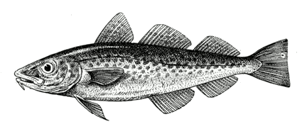



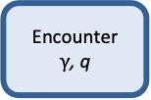
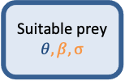
Calculated from von Bertalanffy k
Life-history data (fishbase)
Life-history data or assumed as 0.25*Winf
Regional stomach observations or
Spatio-temperoral overlap
Growth
$$W_{∞}$$
Suitable prey
$$θ, β, σ$$
Encounter
$γ$, q
Assimilation
α, h
Maturation
w_{mat}
Respiration
f_{c}
Reproduction
$$ε_{repro}$$
General (species-specific) stomach observation or literature
Provided by mizer,
usually not touched
Recruitment
$$Rmax$$
Knowledge of Fmsy
Observations of biomass and fishing
Notes:
Caption: Illustration of the parameters needed (blue boxes) and calibrated (green boxes) by Mizer. The need for data is hierarchical: a model can be setup and calibrated with the information in red: knowledge of the asymptotic size and observations of biomass and fishing. The calibration can be refined by adding further information in life history parameters and by using knowledge of Fmsy to calibrate the reproductive efficiency (orange). Additional refinement can be done by specifying the interaction matrix, theta (blue). Other parameters can adjusted, but they are rarely known accurately on a species-by-species basis (black).

